Slide 1
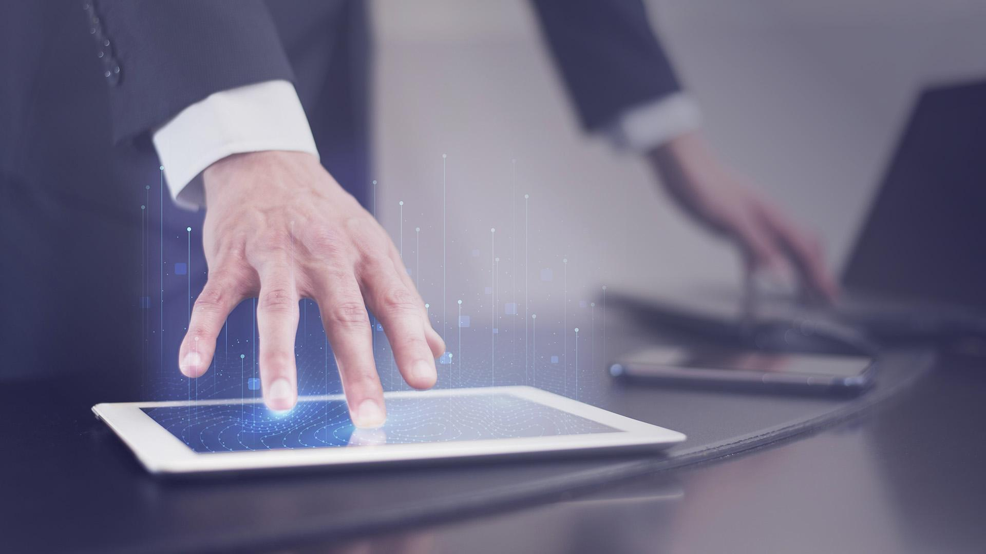
LIVE LECTURE
VISUAL GENERATION

Slide 2
ABSTRACT
This project aims to address the challenges faced by students in traditional lectures, such as struggling to keep up with the lecturer's pace and losing track of concepts due to lack of imagination and distractions. The existing Visual generation softwares like DreamCloud, Dall-e, and Deep-AI can only convert text into visuals, lacking the ability to recognize and convert live voice. To overcome this limitation, we are developing a system that recognizes the lecturer's voice, understands the lecture content, and generates visuals in real-time. The scope of this project includes using NLP, and graphical tools like Canvas. Through user testing and analysis of student engagement and learning outcomes, we will evaluate the effectiveness of the system. The goal is to significantly improve student engagement and learning outcomes compared to traditional lectures, potentially revolutionizing the delivery and reception of lectures in ICT based education. This project will provide valuable insights into the use of NLP and Graphical tools, paving the way for new and innovative teaching methods.

Slide 3
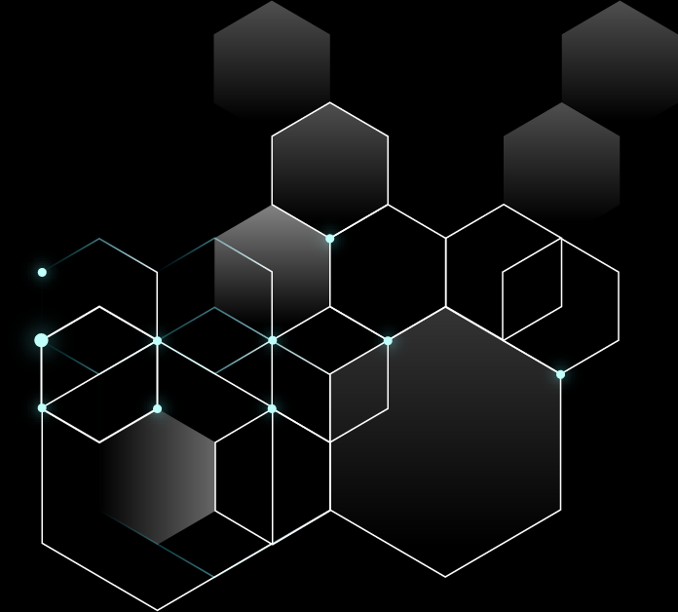
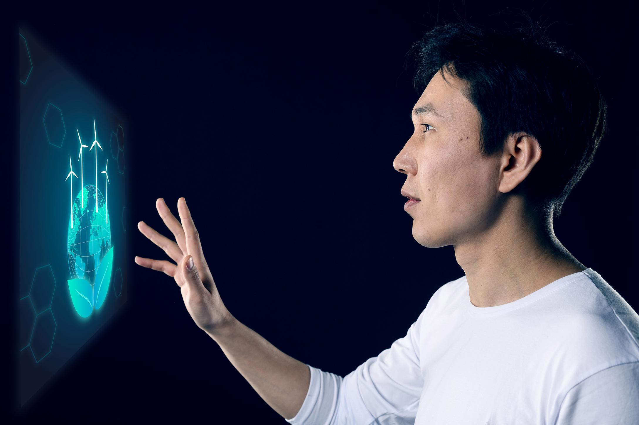
PROBLEM STATEMENT
Develop an System to automate lectures into animation for an engaging and interactive learning experience.
In this project, the domain is limited few concepts of the geometry in mathematics.

Slide 4
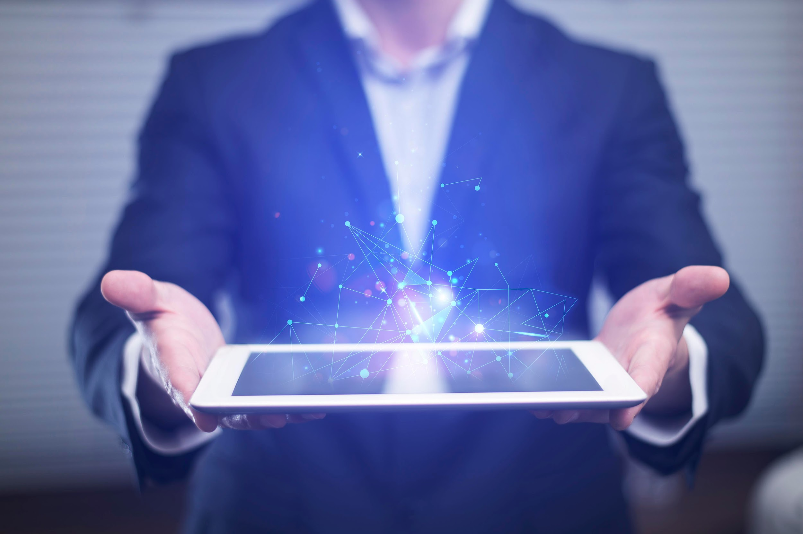
Existed System
Dall-E
An AI system that can create realistic images and
art from a description in natural language.
Deep.AI
An AI tools for naturally creative humans. DeepAI offers a suite of tools that use AI to enhance your creativity.

Slide 5
PROPOSED SYSTEM
These are the Advantages of Proposed system over Existing System:]
It can able to understand the voice
It can able to generate visuals using Voice
It can able to generate visual using text
l

Slide 6
CURRENT APPROACH
1. Speech Recognition:
The system should understand the lecturer’s voice and present it
as a text
2. Text Processing
The lecture text should be process and converted in a way to
represent data that could be understand by the system.
3. Data Representation Format
The data representation format that is considered in this project will
be hierarchy of class as follows:
Shape –> edge and angles -> points

Slide 7
4. canvas Visualization:
The data from data representation format will be visualized using the canvas tools in python.
5. Interface:
We want to design an interface that shows the visulas

Slide 8
Technologies Trying to Use
Natural Language Processing
Turtle Graphics
Canvas Graphics
Deep Learning

Slide 9
Working
This live lecture visual generation takes a sample of voice and converts into text and generates the visuals using text.
It generates the effective visuals using text
It generates the visuals using voice

Slide 10
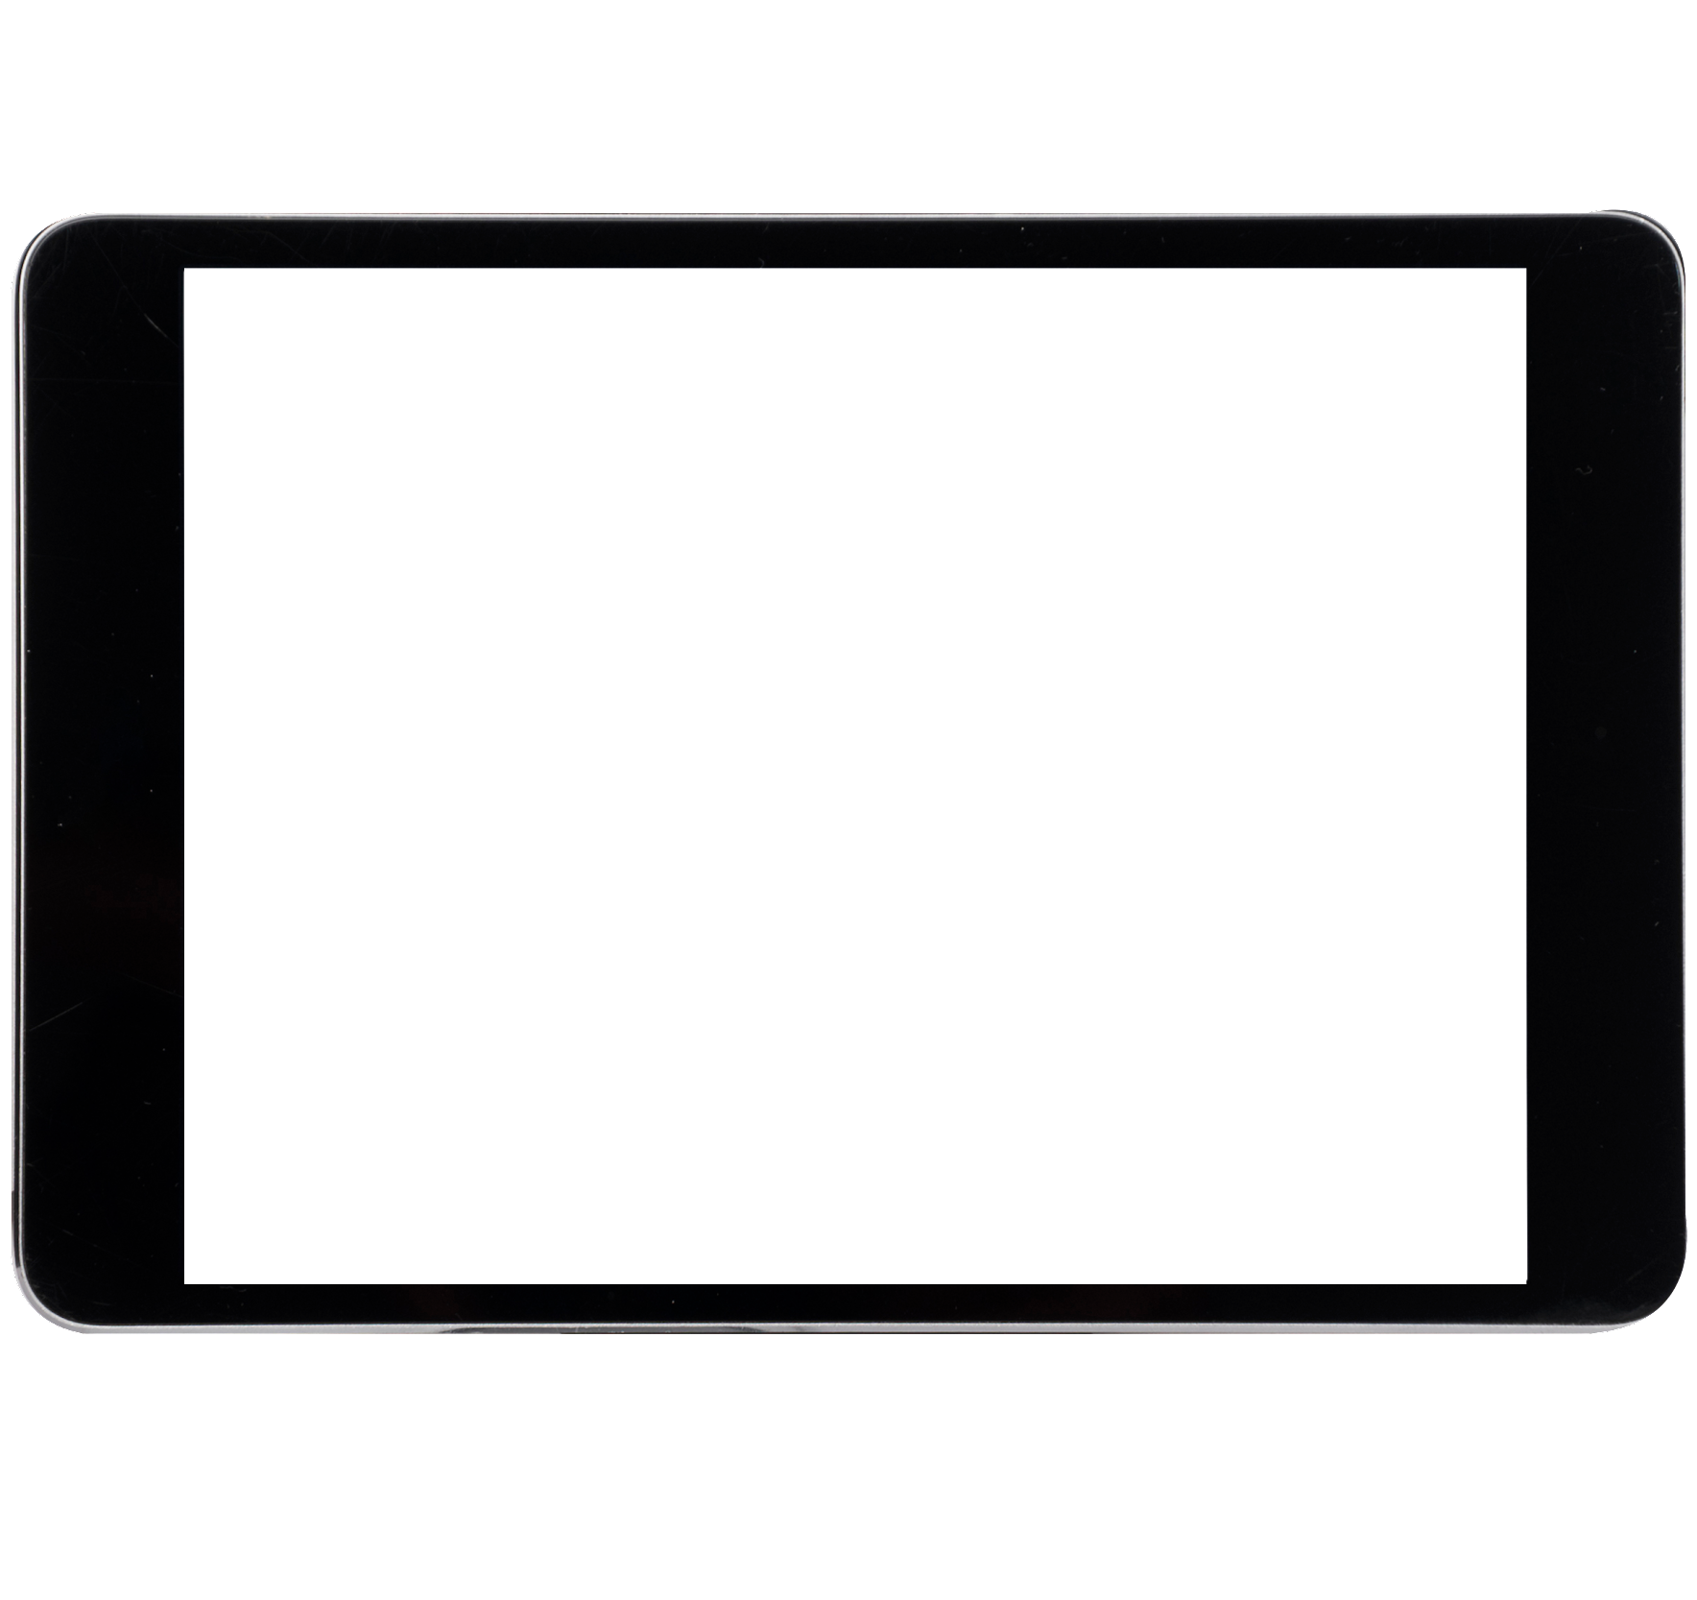
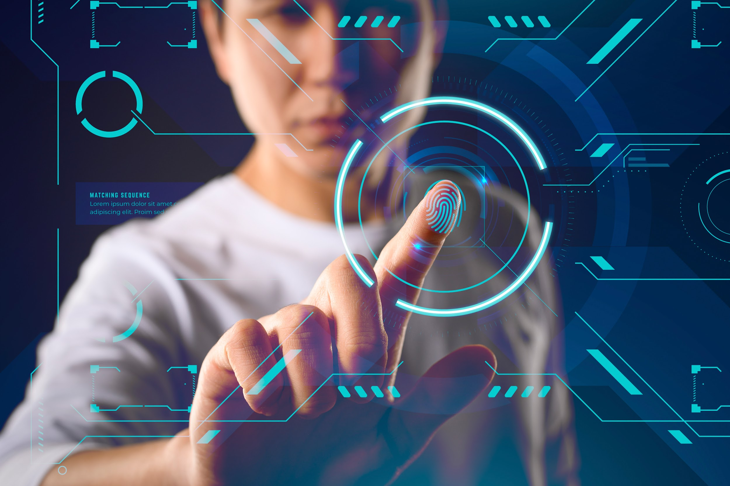
THANK YOU
Team-25
G. Uday Sankar(S180443)
V.sankararao(S180681)
T.SaiKumar(S180020)

